Slide 1
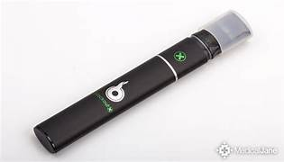
Juuling
Information for students

Slide 2
Juuling
Devices have only been on the market for a few years
“Relatively” new
Preliminary studies
Every person who uses a Juul-like device is a LAB EXPERIMENT
Notes:
-Vaping devices have only been on the market for 10 years.
-Because vaping is “relatively” new, there are only preliminary studies about the affects it has on your health and well-being
Right now, every person who vapes is a LAB EXPERIMENT

Slide 3
Juuling and E-Fluids
Toxic to a teenager’s developing brain & body
It does not matter if the fluid is nicotine, herbal or only flavored
All e-fluid is Glycerin or Propylene Glycol based
When heated, those 2 chemicals break down into:
Formaldehyde (used to preserve dead tissue) or Acetaldehyde (toxin in alcohol)
These chemicals are known to cause cancer and liver damage
Notes:
All e-fluids are toxic to a teenagers developing brain & body

Slide 4
Juuling/E-Fluids
Small particles in the e-fluid, vapor, and coil can get deep into the lung tissue and cause:
Chronic Bronchitis, Cough or Permanent Lung Damage
These small particles can be heavy metals (i.e. nickel) and can cause heavy metal poisoning with long term use
Super heating the liquid by “dripping” or using an atomizer turns the e-liquid into a toxic substance

Slide 5
Affects Juuling Has On Your Body
Dehydration
Dry skin, rashes, dry mouth, dry eyes, throat irritation, cough, headache and nose bleeds
Allergic Reactions
Flavorings and ingredients are not always listed on the fluid packaging or the manufacturer’s website.
Allergic reactions include: congestion, difficulty breathing, clearing throat often and anaphylaxis.
Allergies to the flavorings and chemicals in e-fluid can develop with prolonged use

Slide 6
Affects Juuling Has On Your Body
Nicotine
Dizziness, lightheaded, headache, nausea, cold sweats, insomnia, racing heart, anxiety and ringing in ears
Bodily Harm
Lithium ion batteries do explode and cause burns

Slide 7
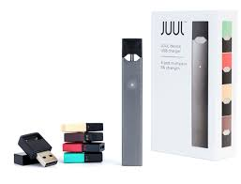
video
Click on photo to play video.

Slide 8
Preliminary Studies
There is NO proof that Juuling is safer than cigarettes
It will decrease your immunity
You will get sick more often, feel sicker, and the sickness will last longer than people who don’t vape
Causes bloody sores that do not heal in the mouth and on your gums
This will lead to gum disease and tooth loss as an adult

Slide 9
Preliminary Studies continued.…
Juuling DOES affect the developing brain in teenagers
The human brain is not fully developed until around the age of 25.
The Pre-Frontal Cortex is the part of the brain that is not developed, and it is damaged by vaping.

Slide 10
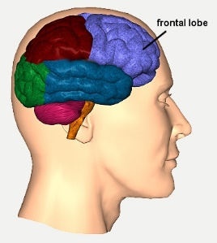
Pre-frontal cortex
decision making
personality
identifying right from wrong
critical thinking skills
Notes:
The pre-frontal cortex controls: decision making, personality, identifying right from wrong, and critical thinking skills used to determine what outcomes and consequence could occur based on our actions

Slide 11
Simply PUT….
Juuling is harmful & will cause lasting damage to you and everyone you expose around you.

Slide 12
School consequences for Juuling:
phone call to parents or guardians
a mandatory two-week assignment to the STAR program (including an educational on-line packet on the dangers of Juuling to be completed prior to exit – takes five to six hours to complete)
3. law enforcement will be notified and a ticket will be issued
4. depending on the content of the substance in the Juul, a possible referral to the Kid Clinic for a substance abuse evaluation or screening will be made
5. 2nd offense would result in an Out-of- school suspension and/or an extended STAR assignment.

